Slide 1
How to fill out Blue City Sales Tax Return form
Step by Step instruction on how to file Quarterly City Sales Tax Return Form.
Prepared by your friendly city tax division.

Slide 2
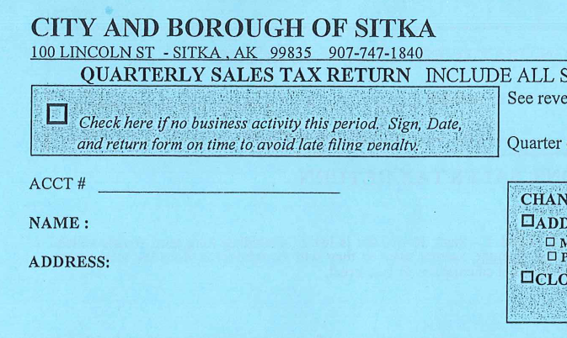
Business information
Instructions
Fill in Business information:
Account number
Full name of Business
Business owner name (first and last name)

Slide 3
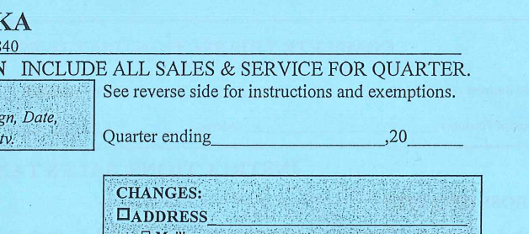
Quarter Ending (Top right corner)
List the quarter end month:
Quarter 1: Jan, Feb, Mar
(Quarter ending Mar)
Quarter 2: Apr, May, Jun
(Quarter ending Jun)
Quarter 3: Jul, Aug, Sep
(Quarter ending Sept)
Quarter 4: Oct, Nov, Dec
(Quarter ending Dec)

Slide 4
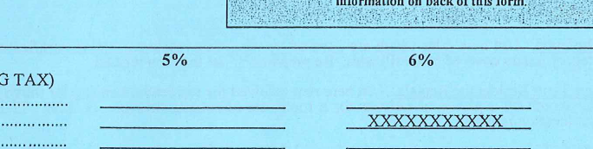
Tax % Collection/Remission
Fill out your Tax information on each side according to when tax was collected
5% Tax is to be collected during Quarters 1 &4
(Jan, Feb, Mar, / Oct, Nov, Dec)
6% Tax is to be collected during Quarters 2 & 3*
(Apr, May, Jun, / Jul, Aug, Sep)
*The Exception to this is ‘Long Term Rentals’ which are to be collected at 5% year round

Slide 5
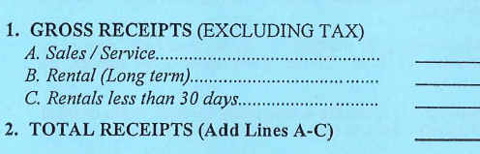
Line 1 & 2: Gross Receipts (Excluding Tax)
Line 1: Gross Receipts: This is where you fill out the total dollar amount collected for the sale/service. This amount is broken down into 3 subsections.
Sales/Services
Rental (Long Term): Tax Collected at 5% year round
Rental less that 30 days: Tax collected at 5% or 6% based on when services was provided. AS WELL AS a 6% Bed Tax (See Bed Tax Form on Slide #15)
The dollar amount listed on these lines should NOT include tax!
Line 2: Add Lines A-C from Line 1.

Slide 6
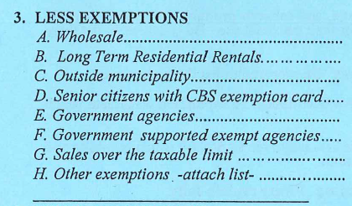
Exemptions! (Line 3)
Line 3: This is where you will deduct the tax exempted sales from your Total Gross Receipts.
The City of Sitka has a full list of approved exemptions to be found in SGC 4.09.100
Click here for a link to this section of the code!

Slide 7

Exemption A : Wholesale
SGC 4.09.100
P. Resale. A sale for resale of a product, service or rental to a consumer where the resale is subject to tax is exempt.
This exemption is to be used when the business provides a sale or service that is to be taxed by the end user. The business or buyer that is receiving the ‘wholesale’ service or sale is to collect and remit city sales tax on this dollar amount.
The business or buyer of this product should have a wholesale/resale exemption card.
Wholesale number should match the tax exempt log that must be filled out by the tax exempt buyer for each tax exempt sale. Copies can be found HERE

Slide 8
Exemption B : Long Term Residential Rentals
SGC 4.09.100
AA. Residential Rent. Rent paid for residential housing for thirty or more consecutive days or an entire calendar month by a person or persons for a room, set of rooms, structure, or suite is exempt from sales taxes.
Rentals Less than 30 days: This exemption does not apply to any transaction taxable under Chapter 4.24 regarding the hotel, motel, and bed and breakfast transient room tax.
Long Term Rent collected at 5% year round includes commercial and business space rent and is not exempted under this exemption

Slide 9
Exemption C : Outside Municipality
SGC 4.09.100
M. Outside City and Borough. Sales of goods or services resulting from orders received from outside the city and borough by mail, telephone, or other similar public communication where delivery of the property or performance of services ordered is made outside the city and borough are exempt.
This exemption includes two separate parts for sales and for services.
Services that are provided to someone outside of the CBS and performed outside the CBS are exempt.
Sales made by mail or phone to be delivered outside of the CBS are exempt.

Slide 10
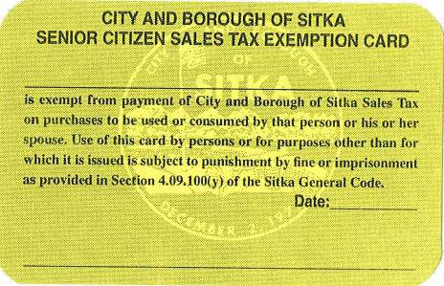
Exemption D : Senior Citizen Exemption
SGC 4.09.100
Y. A resident senior citizen (persons over the age of 65 who reside full time in Sitka) who holds a CBS issued senior exemption card may make personal use purchases tax exempt.
(Link to full exemption description HERE)
Example of a CBS issued Senior Tax Exempt Card:
Full Legal Name
Tax Exempt Number
(4 Digit)
Seniors may not use their tax exemption for:
a. For use in any trade or business, including but not limited to commercial fishing (non-personal use)
b. For purchase of alcoholic beverages, cigarettes, or other tobacco products.
No. ****
Signature
This should match the tax exempt log that must be filled out by the tax exempt buyer for each tax exempt sale. Copies can be found HERE

Slide 11
Exemption E : Government Agencies Exemption
SGC 4.09.100
G. Governmental Agencies. A sale directly to any federal, state, municipal or tribal government, or any department or agency of these governments, is exempt.
This should match the tax exempt log that must be filled out by the tax exempt buyer for each tax exempt sale. Copies can be found HERE.

Slide 12
Exemption F : Government Supported Exempt Agencies
SGC 4.09.100
V. Government-Funded Agencies. Nonprofit organizations that qualify as tax exempt under IRC Section 501(c) AND derive fifty percent or more of their gross revenue from local, state, or federal government sources are exempt from paying sales tax if they hold a tax exempt certificate.
This should match the tax exempt log that must be filled out by the tax exempt buyer for each tax exempt sale. Copies can be found HERE.

Slide 13
Exemption G : Sales Over the Taxable Limit
SGC 4.09.100
N. Over $12,000 on Sales and Rents of Tangible Personal Property and/or on Sales of Services, and Over $12,000 in Rent or Lease of Real Property on a Monthly Basis. That portion of a selling price for a single piece of equipment or tangible personal property or sale unit in excess of $12,000 is exempt.
This line can be a little tricky for some. We would like to know is the dollar amount of the sale price that is in excess of $12,000.
Example: Mary sells a large paintings for $14,525. She should charge sales tax on the first $12,000 for each sale (5% $600 or 6% $720) because the amount paid over $12,000 is exempt from taxation. On the blue tax return form Mary would write on line G. $2,525 as this is the amount in excess of $12,000 for each invoice that is tax exempt. If multiple transactions are made under this exemption you must add the excess amounts together. So, if Mary made another large sale, say $23,200 her equation would look like this: ($14,525 - $12,000 = $2,525 & $23,200 - $12,000 = $11,200 So, $2,525 + $11,200 = $13,725 would be written on line G.)

Slide 14
Exemption G : Sales Over the Taxable Limit
SGC 4.09.100
Other exemptions include but not limited to:
Lottery Tickets/Pull Tabs
Newspapers
Freight/Wharfage
Medical/Veterinary Services
Public Transportation
Child/Adult Care
Commission
Fees (Bank, Court, Membership)
Church Sales

Slide 15
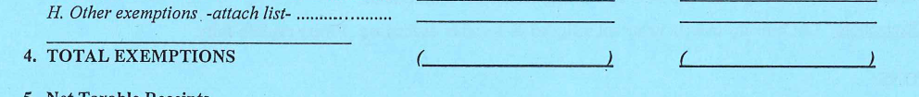
Line 4: Total Exemptions
Add up all exemptions* (Lines A-H) and input number into ( _______ )
* If you do not have any tax exempted sales put a 0 in this line

Slide 16
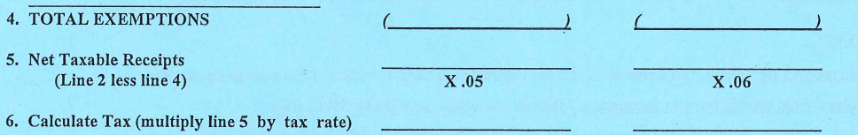
Line 5: Net Taxable Receipts
Total Sales
Exempted Sales
Net Taxable Receipts

Slide 17
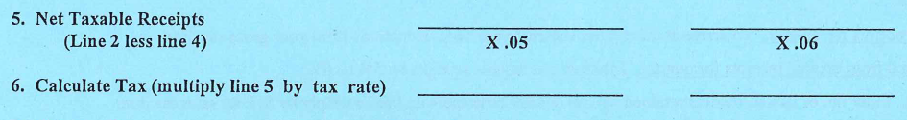
Line 6: Calculate Tax
Remit/Pay this amount by due date
Line 6: Is the Tax amount ($) to remit to the City and Borough of Sitka.
Below is the basic equation to summarize the purpose of this form.
Gross Sales – Exempted Sales = Net Taxable Receipts x Tax Rate (5% or 6%) = Tax $ to Remit

Slide 18
Line 7: Fish Box Tax
SGC 4.09.010 C. A flat rate of ten dollars per fish box shall be levied on the packaged fish and/or seafood caught or taken and retained by fish charter customers as part of the fish charter. This tax shall be paid by the fish charter customer, collected by whoever packages the fish and/or seafood caught or taken by the fish charter customer, and is in addition to any sales tax paid based on the cost of the charter. This tax is effective January 1, 2007. For purposes of this subsection, a “fish box” means any packaging by a fish charter operator or processor of fish and/or seafood caught or taken as part of the charter by a fish charter customer. The sales tax collected from this levy on fish boxes shall be deposited by the finance director in the following funds in the following ratios:
Thirty percent in the harbor fund;
Thirty percent in a fisheries enhancement fund, available to be used for any fisheries enhancement proposal upon approval of the proposal by the assembly; and
Forty percent in the general fund.

Slide 19
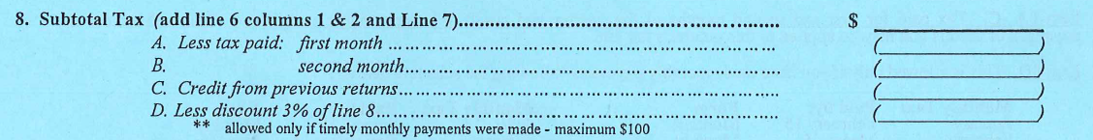
Line 8: Subtotal Tax
Line 8: Is the same number as line 6 unless business is remitting Fish Box Tax, then Line 8 = Line 6 + Line 7.
Line 8 Sub-sections (to be subtracted from Subtotal Tax amount) :
(A.) : Taxes remitted/paid in advance for the first month of the current filing quarter
(B.) : Taxes remitted/paid in advance for the second month of the current filing quarter
(C.) : Credit (usually from over payment) that remains on account and is available for use
(D.) : Discount* option is only available for business’s that make both monthly payments before the 15th of the following month (received or post marked)
*Discount is calculated based on dollar amount of tax remitted multiplied by 3% (.03) – max discount $100

Slide 20
Line 9, 10, 11: Penalties for Late Filing and/or Payment
Line 9: If return (blue form) is not received or post marked by the due date a $15 fee is charged on the next day for the first month.
Late Fee Schedule: 1st Month = $15 Late Fee ; 2nd Month = $40 ; 3rd Month = $65 ; 4th Month = $90.00 ; 5th Month = $100
Line 10: If payment is not received or post marked by the due date a 5% penalty is charged on the next day for the first month.
Late Payment Penalty Schedule: 1st Month = 5% ; 2nd Month = 10% ; 3rd Month = 15% ; 4th Month = 20% ; 5th Month = 25%
Line 11: If payment is not received or post marked by the due date a 12% interest is charged on the next day and continues by day until payment is made.
Calculation: Sales Tax Remitted ($) x (.12) x (# of days late) / (365) = Interest ($) added for late payment

Slide 21
Line 12: Amount Due from Previous Return
$
Line 12: If, when you receive the blue form in the mail, there is a dollar amount in this field, this means the business owes tax remission from previous quarters.* This must be paid along with tax remission for current quarter to avoid additional penalties and interest.
*This should not be the first time seeing that the business has a outstanding balance. You should receive a letter in the mail after the conclusion of the quarter if tax is owed. The tax clerk usually makes a courtesy call before letters are sent. If there is an unpaid balance, it is subject to penalty and interest, calculated based on a percent of amount owed, until balance is paid in full.

Slide 22
Line 13: Total Amount Due with Return
Line 13: If you’ve followed the instructions up to this point the amount for Line 13 will be the amount that is required to be remitted. This line is the balance due as of the date of the return, if the return is late, this should line should include any late fees penalties and interests, less any pre-payments or discounts.
Tax Payments cannot be made by Credit Card!
ONLY Check or Cash payments are accepted for tax remission.

Slide 23
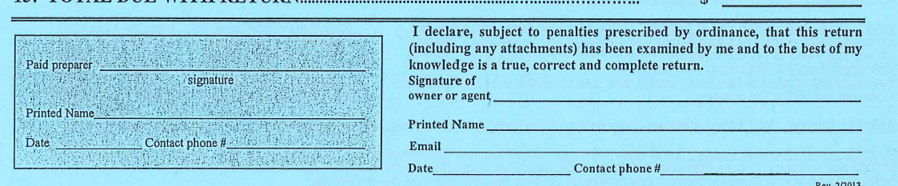
IMPORTANT!
SIGN HERE
You MUST sign and date your return for the information to be valid. Also, please leave us a contact number or e-mail in case we have questions regarding your return.

Slide 24
Frequently Asked Questions:
Call 907-747-1853 or 907-747-1840 to answer questions on filing a return
Thank you!

